Slide 1

Top5ive (Working Title) – Progress Demo
Showcasing Key Features and Progress
Daysha Roberts

Slide 2


Problem Statement
Problem: Sharing playlists is messy and discovery is weak.
Solution: Top5ive lets people create playlists and discover them through search, tags, and likes.
Target users: students, DJs, music lovers, creators, classmates testing the app.

Slide 3
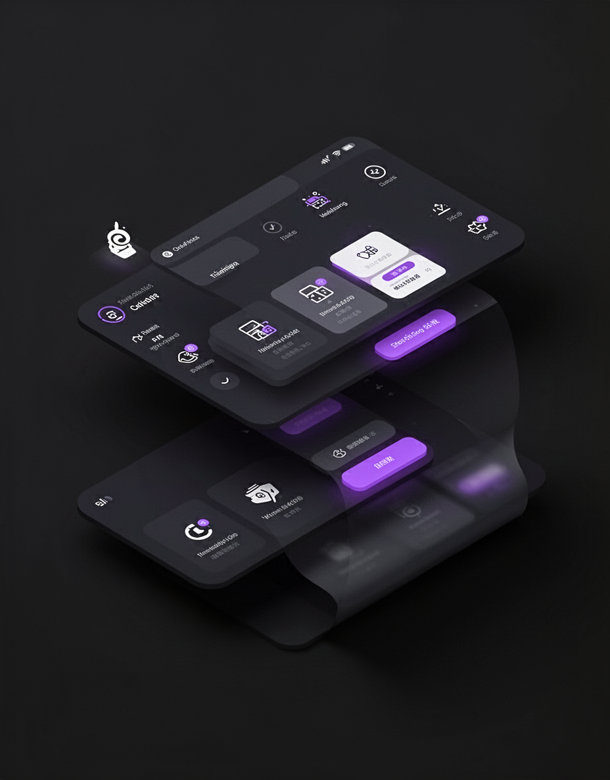

Proposed Features
Public/private playlists
Tags for discovery
Explore page (search + filter)
Sort by newest / most liked
Playlist detail page + shareable link
Likes as social proof
Creator profiles (planned)

Slide 4
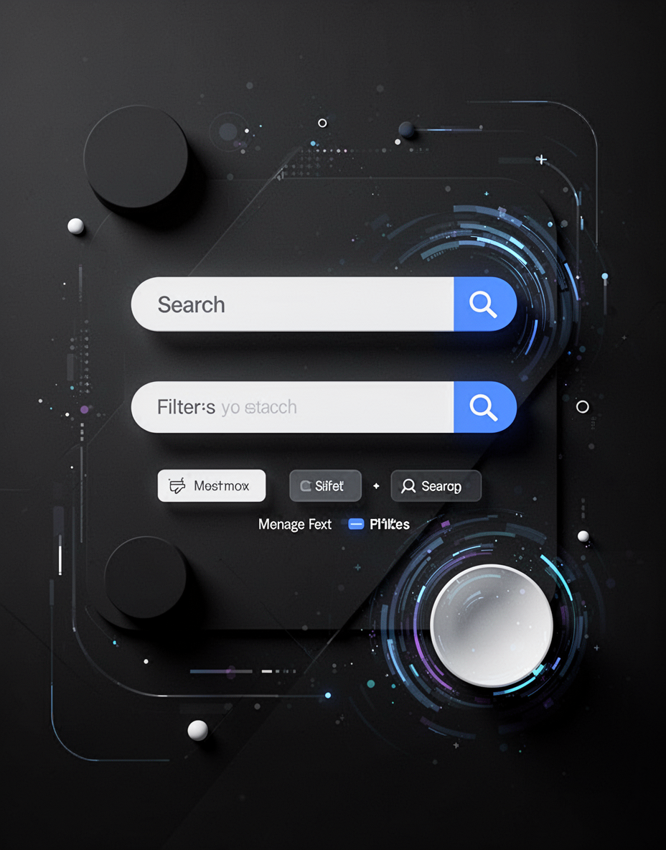
Modifications
Switched from DJ productivity app → playlist sharing social app
Branding concept update: exploring “The Queue” luxury club vibe (pending instructor approval).
Prioritized UI + discovery flow first for April testing
Backend/auth stabilization scheduled after UI demo is solid

Slide 5
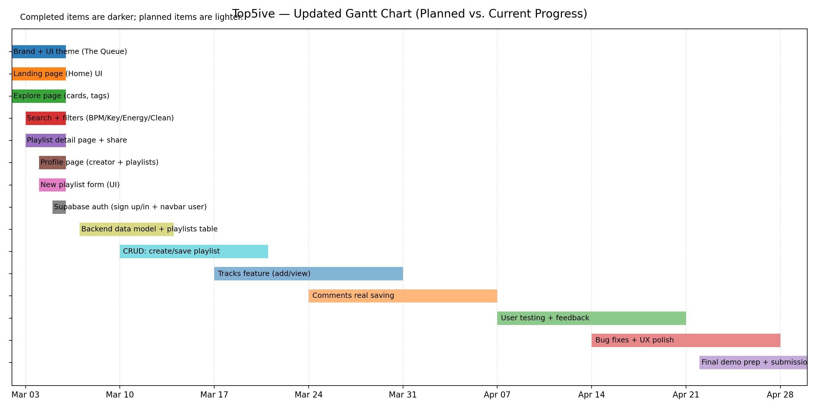

Slide 6
Progress Tracking
Completed:
Explore UI
Search
Tag filtering
Sorting
Playlist cards + detail navigation
In progress:
Backend integration (DB/auth)
Next:
Tracks feature, delete playlist, liked playlists tab

Slide 7
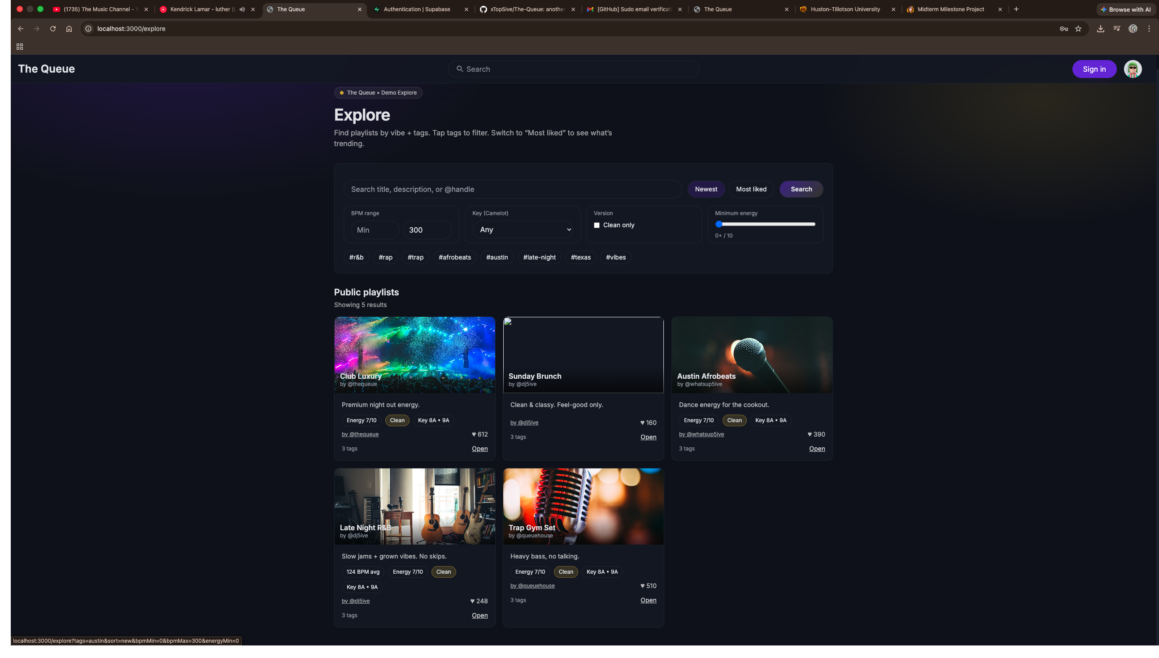
Explore Page
Explore page with playlist cards and tags

Slide 8
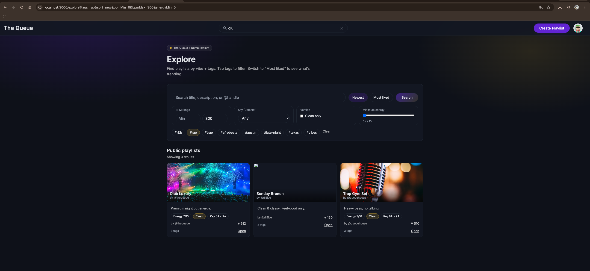
Search + Tag Filtering
Search narrows results, Tags stack to filter, Filters update via URL params

Slide 9
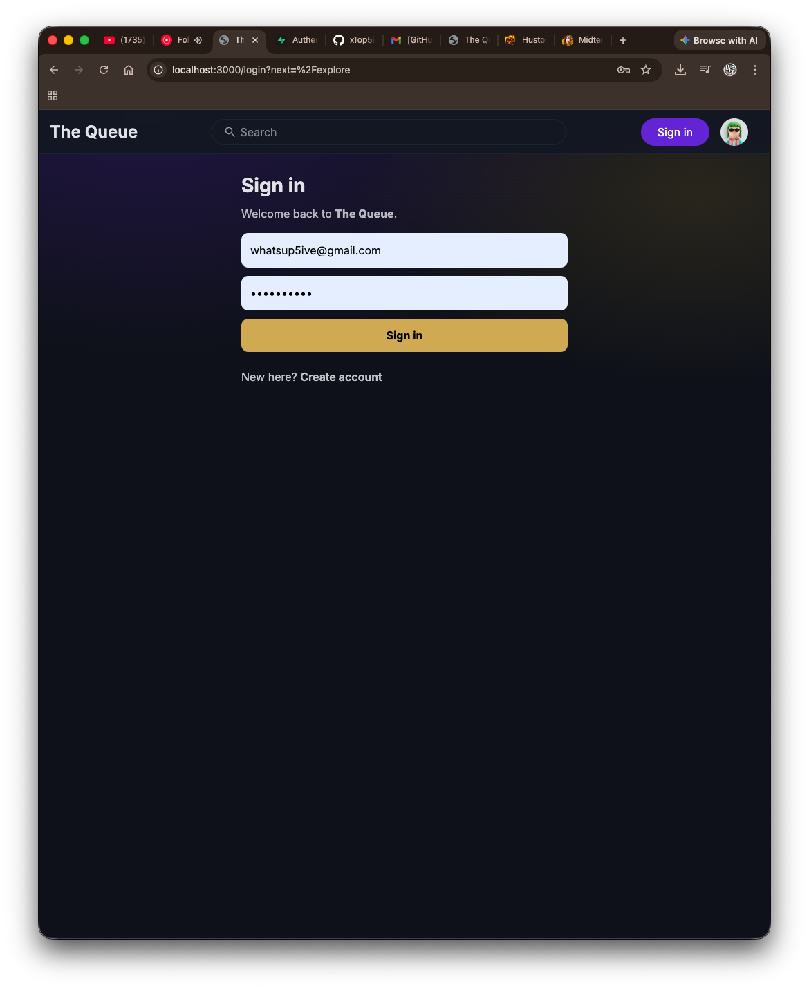
Log in screen
Email + password sign in (Supabase Auth)
Create account link for new users
Redirects back to the page you were trying to access (“next” routing)
Navbar updates after login (shows user name + profile menu)

Slide 10
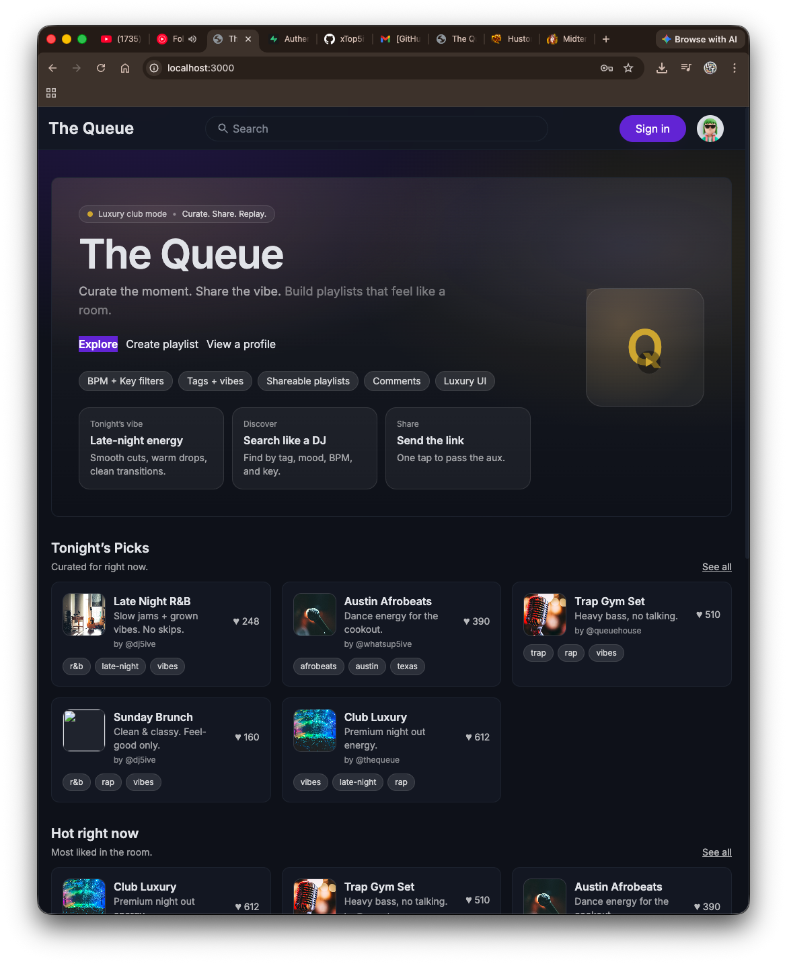
Landing Page
Premium “luxury club” hero for The Queue
Quick actions: Explore + Create playlist
“Tonight’s Picks” and “Hot right now” sections powered by demo playlists
Designed to make discovery feel curated, not random

